Slide 2
بسم الله الرحمن الرحيم
Holistic Halal Audits
by
Sarfraz Mohammed
Sharia Auditor
Halal Monitoring Committee
U.K. (HMC)
.

Slide 3
HOLISTIC HALAL AUDITS
By the end of this presentation hopefully the need for holistic halal audits will be clearer

Slide 4
Scope
1. Towards a holistic halal audit-Criteria
3. Importance of transparency & openness in auditing
2. Case study of a confectionery plant

Slide 5
Some Key Components of a Holistic Halal Audit
CHECK
Ingredients
Cleaning agents
CHECK
Manufacturing process
Packing
CHECK
Storage
Transport

Slide 6
Case study – confectionery audit

Slide 7
INGREDIENTS – Use of Gelatin
The manufacturing plant only uses bovine gelatin, porcine gelatin is not used at all.
Cross-contamination from a clear haram ingredient i.e. from a porcine source is eliminated

Slide 8
Gelatin cross contamination
Plant uses both halal certified bovine gelatin and
bovine gelatin from a non-halal source.
Here potential cross-contamination is possible…

Slide 9
Non-Zabiha Bovine Gelatin – pure or impure?
Bovine gelatin including the hide of non-Zabiha cattle is not considered to be impure by many contemporary scholars.
This is due to the liming process used in its manufacture which removes all blood, impure liquids etc. from the cattle hide, giving it the ruling of a tanned hide in the Sharia…

Slide 10
Consumption of non-zabiha Bovine gelatin?
According to the majority ) (الجمهور of Islamic scholars, although ‘pure’, tanned non-Zabiha hide cannot be consumed
A minority of scholars including Imam Shafi permit it’s consumption

Slide 11
Lab test for Buffalo hide

Slide 12
Lab results for limed buffalo hide
Limed buffalo hide was confirmed to be preserved by an independent lab test
PCSIR laboratory comment;
‘‘The lime treatment is effective in controlling microorganisms in the buffalo hides and is being used for preserving skins and hides world over’’

Slide 13
MANUFACTURING PROCESS – cross contamination issues
Use of the same machine for Zabiha gelatin and non-Zabiha gelatin can be done if the machine is washed out using hot water before Halal production.

Slide 14
CLEANING AGENTS – use of alcohol based cleaning agents
Sugars, oils etc. from confectionery are often removed from machines via alcohol based detergents
This can be dealt with by either using an alternative non-alcohol based detergent OR
By removal of the detergent after cleaning by a wash down with standard water

Slide 15
Hadith on removing impure substances by water
There are a number of hadith which indicate the purifying nature of water, one such authenticated hadith is narrated in the next slide…

Slide 16
…So I (ibn Abbas ra) said to him (the prophet peace be upon him) we travel together with these non-Muslims and they have pots in which they cook unslaughtered animals (maytah) and the meat of the pig, he (the prophet peace be upon him) said; that which is earthenware (Fakkhaar), boil water in it and wash it with water, and that which is made from copper (Nuhaas) wash it with water, water is a means of purification for everything (tuhurun li kulli shay).
Hadith no.7153, Kitaab al-Attima , Al-Mustadrak of Al-Imaam Al-Hakim

Slide 17
Water is the Universal Cleaning Agent

Slide 18
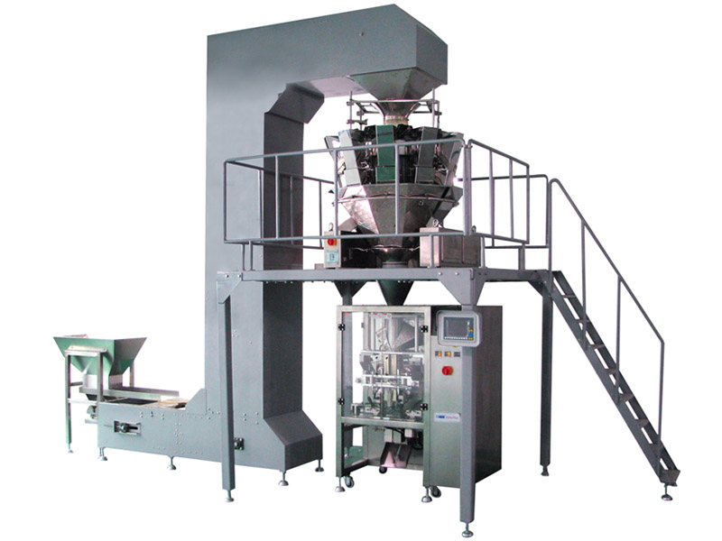
Packing – cross contamination
The packing machine was washed down with an alcohol based detergent

Slide 19
Alcohol based detergent

Slide 20
Removal of non-conformity
All parts were subsequently cleaned using water before sweets were packed
This process of washing with standard water was then made a standard for packing on this machine
Key point; this non-conformity had occurred even though the firm had been informed and agreed in writing not to use alcohol based detergents

Slide 21
Holistic includes being hands-on
This underlines the importance of being present for site inspections during production, to ensure halal standards are actually implemented
In short for the halal certification process to be truly reliable and credible, it cannot suffice with mere paperwork exercise

Slide 22
Storage & Transport

Slide 23
Storage & Transport
Ensure all halal raw materials and finished products are segregated and identifiable to eradicate cross contamination
Separate storage area for halal products is to be promoted to reduce the potential of cross contamination
Standard policy with the Soil Association in the U.K. for Organic certification

Slide 24
IMPORTANCE OF TRANSPARENCY & OPENNESS IN AUDITING

Slide 25
Disclosure of halal criteria
It is observed from anecdotal evidence that the non-Muslim and even Muslim manufacturers and the general public are sometimes confused as to what the term halal actually refers to

Slide 26
Improving transparency
Non-Muslims in particular should be informed of what the term halal means
This guidance is more important in the current context due to the absence of a universal halal standard

Slide 27
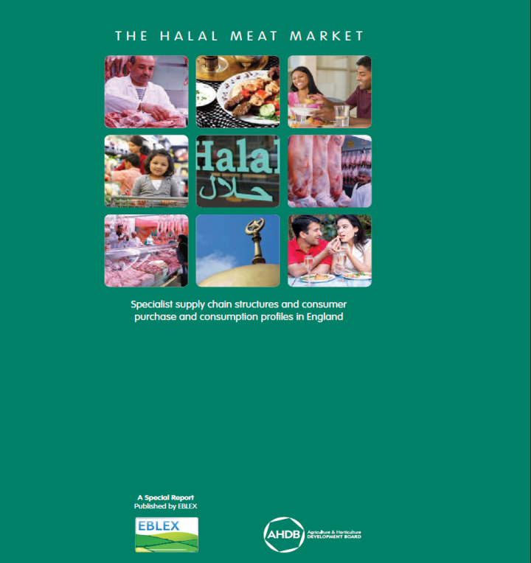
Eblex Report ( U.K. Agricultural and Horticultural Development Board 2010 )
Analysis of Muslim understanding
on what constitutes
Halal meat and Non-
Halal meat…

Slide 28
Findings on the U.K. Halal meat sector
Question: What constitutes halal meat for a Muslim ?
5O% of Muslim respondents believed that having other animals in proximity to the slaughter invalidated the meat as halal
40% believed that buying meat from a non-Muslim would render the meat unacceptable

Slide 29
Benefits
Benefits of disclosure and education of what is halal and what is non-halal, helps develop awareness
Opportunity to highlight potential areas of concern to the auditor
Appropriate solutions can be explored immediately.

Slide 30
Conclusion
Halal audits need to incorporate carefully conducted site inspections for each KEY part of the production process, thus making the audit more holistic and more affective.
Transparency in the certification process should help to achieve better results in identifying actual and potential problem areas

Slide 31
Thank you شكرا
And a special thanks to the organisers for their dedication to Halal, their warm welcome and generous hospitality
و آخر دعوانا ان الحمد لله رب العالمين
Sarfraz Mohammed
Sharia Auditor
Halal Monitoring Committee U.K. (HMC)
Sarfraz.mohammed@halalmc.org

Slide 32
Thank You
HALAL RESEARCH COUNCIL
Head Office: 192- Ahmad Block, New Garden Town , Lahore, Pakistan Ph: +92 42 35913096-8 , Fax: +92 42 35913056 E-mail : info@halalrc.org Web: www.halalrc.org

